Slide 1



Logic Attention Based Neighborhood Aggregation for Inductive Knowledge Graph Embedding
AAAI 2019, HAWAII, HI
Peifeng Wang, Jialong Han, Chenliang Li, Rong Pan

Slide 2
Intro to Inductive KG Embedding
KG
consists of numerous triplet
facts like (s, r, o)
KG embedding
represents entities and relations
in a low-dimensional space
Existing approaches
require all entities be seen
during training
Notes:
Better to use example explanation here

Slide 3
Outline
1. Neighborhood Aggregation Framework
2. Desired Properties of Aggregator
3. Logic Attention Network (LAN)
4. Experiments

Slide 4

1. Framework
Encoder
Transform by relation
E.g., $T_{r}\left(e_{j}^{I}\right)=e_{j}^{I}−w_{r}^{T}e_{j}^{I}w_{r}$ [1]
Aggregate
$e_{i}^{O}=A(\left\{T_{r}\left(e_{j}^{I}\right) | \left(r,e_{j}\right)∈N_{k}(i)\right\})$
Decoder: e.g., TransE [4]
Possible choices for aggregator A
Pooling functions [2], e.g., MAX & SUM
RNNs [3], e.g., LSTM
Aggregator: Focus of This Paper

Slide 5
2. Desired Properties of Aggregator
Permutation Invariant
Neighbors of an entity are naturally unordered.
{Chicago_Bulls, American, Basketball_Player}
Redundancy Aware
Facts in KGs tend to depend on each other.
(play_for: Chicago_Bulls)
->(work_as: Basketball_Player)
Query Relation Aware
Query is given for KG completion tasks.
Whether and how to use such information?
(live_in: ?)
Notes:
Better to use example explanation here

Slide 6
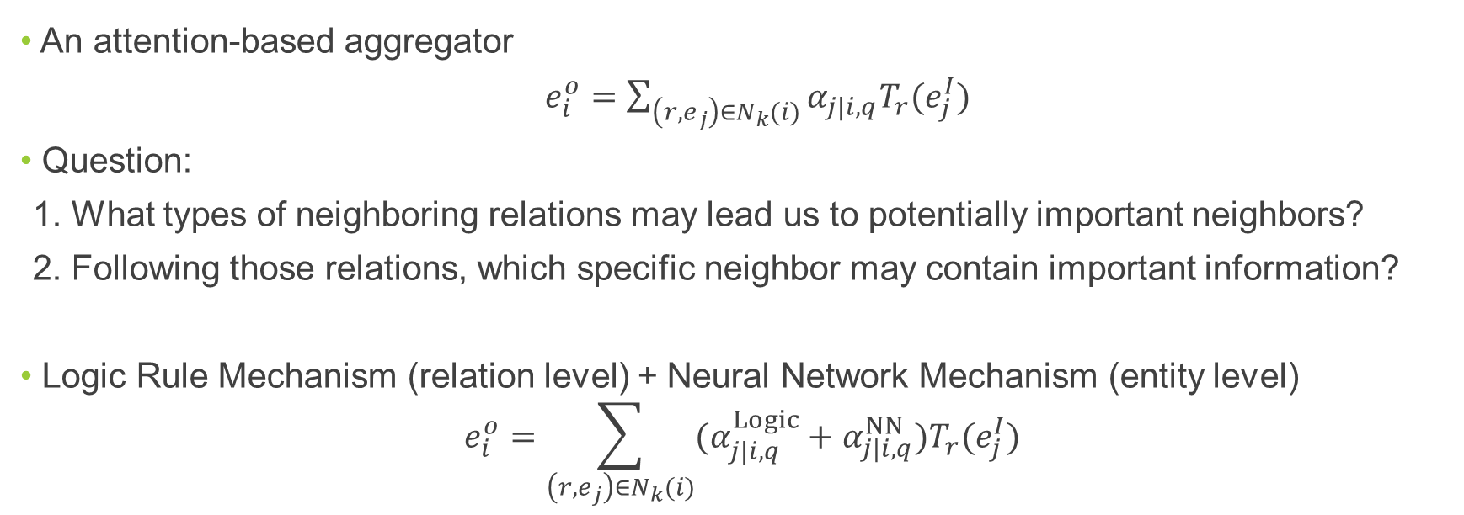
3. Logic Attention Network (LAN)
An attention-based aggregator
$e_{i}^{o}=\sum_{\left(r,e_{j}\right)∈N_{k}(i)}{α_{j|i, q}T_{r}(e_{j}^{I})}$
Question:
1. What types of neighboring relations may lead us to potentially important neighbors?
2. Following those relations, which specific neighbor may contain important information?
Logic Rule Mechanism (relation level) + Neural Network Mechanism (entity level)
$$e_{i}^{o}=\sum_{\left(r,e_{j}\right)∈N_{k}(i)}{(α_{j|i, q}^{Logic}+α_{j|i, q}^{NN})T_{r}(e_{j}^{I})}$$

Slide 7
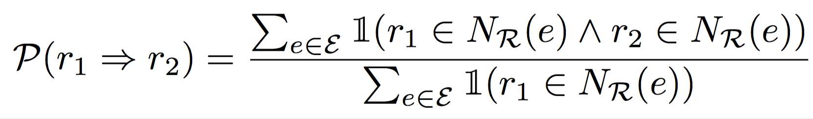
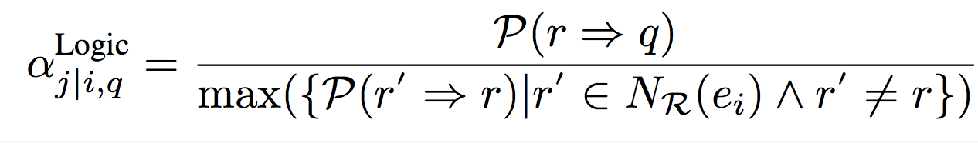
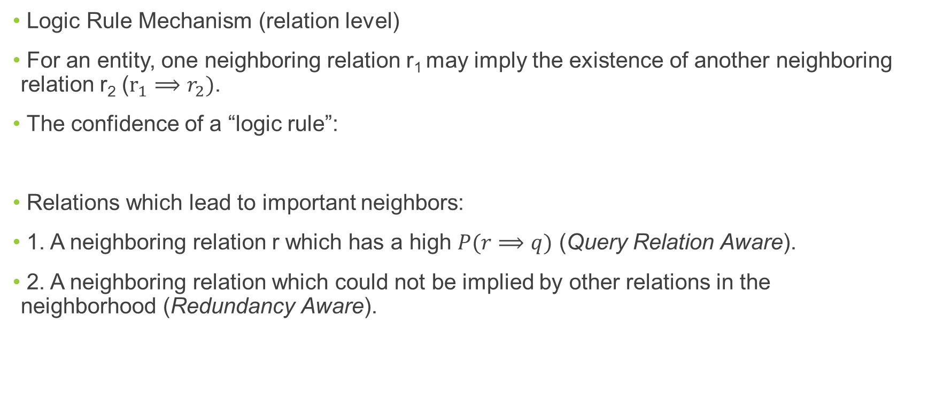
3. Logic Attention Network (Cont’d)
Logic Rule Mechanism (relation level)
For an entity, one neighboring relation r₁ may imply the existence of another neighboring relation r₂ ($r_{1}⟹r_{2})$.
The confidence of a “logic rule”:
Relations which lead to important neighbors:
1. A neighboring relation r which has a high $P(r⟹q)$ (Query Relation Aware).
2. A neighboring relation which could not be implied by other relations in the neighborhood (Redundancy Aware).

Slide 8
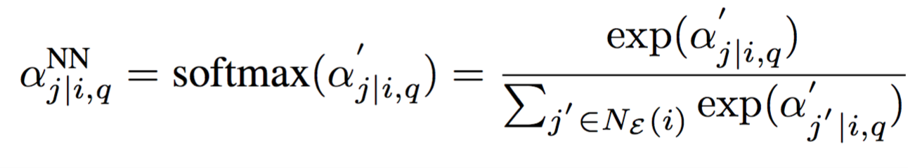
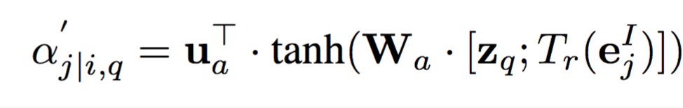
3. Logic Attention Network (Cont’d)
Neural Network Mechanism (entity level)
The neighbor Chicago_Bulls could help to imply the object of live_in since there are other athletes playing_for Chicago_Bulls while living_in Chicago .
Attention network [5]

Slide 9
4. Experiments
KG completion tasks
Triplet Classification: Given a triplet (s, r, o), classify it as true or false.
Link Prediction: Given (s, r, ?) or (?, r, o), predict the missing part ?.
Datasets
Triplet Classification: we use WordNet released by [2].
Link Prediction: we construct a dataset with emerging entities based on Freebase (FB15K [4]).
Baseline Aggregators
MEAN [2]
LSTM [3]

Slide 10
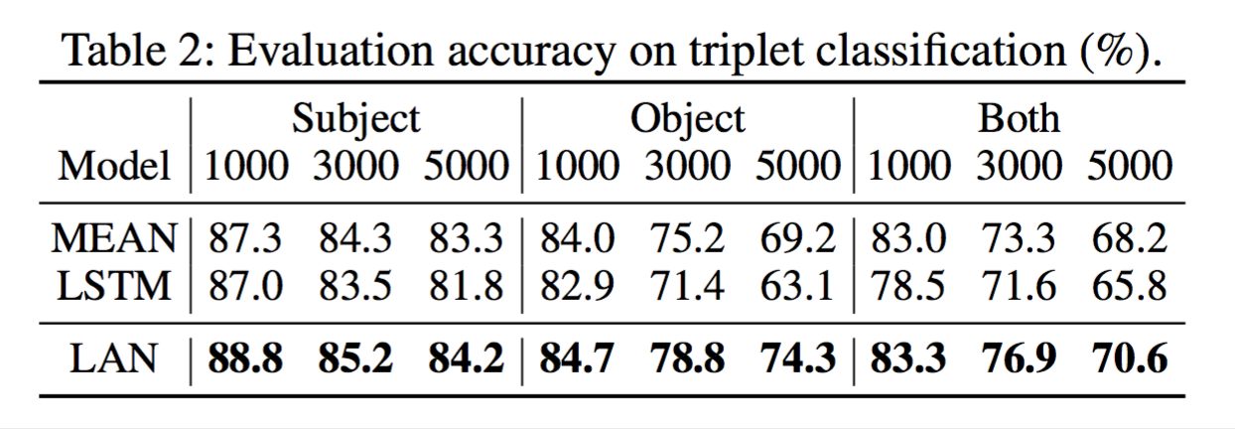
4. Experiments (Cont’d)
Triplet classification

Slide 11
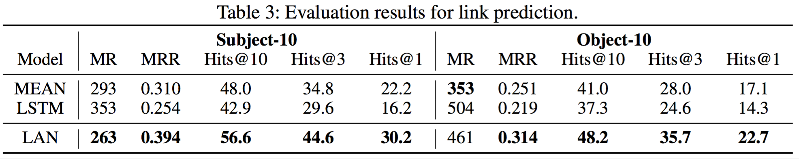
4. Experiments (Cont’d)
Link Prediction

Slide 12
4. Experiments (Cont’d)
Effectiveness analysis (Link Prediction, Subject-10)
1. Necessity of Query Relation Awareness
2. Effectiveness of Logic Rule Mechanism
3. Generalization to other scoring functions
4. Influence of the proportion of unseen entities
5. Case studies on neighbors’ weights

Slide 13
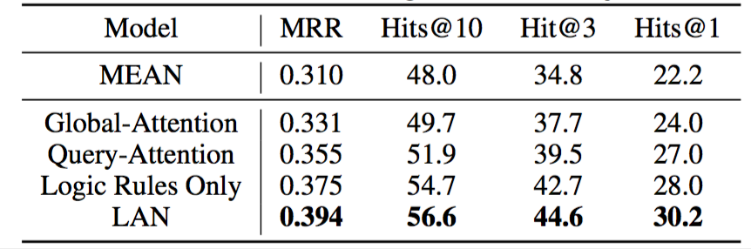
4. Experiments (Cont’d)
Effectiveness analysis
1. Necessity of Query Relation Awareness
2. Effectiveness of Logic Rule Mechanism

Slide 14
4. Experiments (Cont’d)
Effectiveness analysis
5. Case studies on neighbors’ weights

Slide 15
5. Experiments (Cont’d)

Slide 16
Thank you!

Slide 17
Reference
[1] Wang, Z.; Zhang, J.; Feng, J.; and Chen, Z. 2014. Knowledge graph embedding by translating on hyperplanes. In AAAI, 1112–1119.
[2] Hamaguchi, T.; Oiwa, H.; Shimbo, M.; and Matsumoto, Y. 2017. Knowledge transfer for out-of-knowledge-base entities: A graph neural network approach. In IJCAI, 1802– 1808.
[3] Hamilton, W.; Ying, Z.; and Leskovec, J. 2017a. Induc- tive representation learning on large graphs. In NIPS, 1024– 1034.
[4] Bordes, A.; Usunier, N.; Garcia-Duran, A.; Weston, J.; and Yakhnenko, O. 2013. Translating embeddings for modeling multi-relational data. In NIPS, 2787–2795.
[5] Bahdanau, D.; Cho, K.; and Bengio, Y. 2015. Neural ma- chine translation by jointly learning to align and translate. In ICLR.

